Slide 1
Training Presentation
Session 2019-20
Upcoming Event
Information System
Training From:
Grass Solution Pvt. Ltd.
Submitted By:
Princy Garg

Slide 2
Node.js
Technologies are we used
Node.js is a server-side platform built on Google Chrome's JavaScript Engine (V8 Engine). Node.js was developed by Ryan Dahl in 2009.
Node.js is an open source, cross-platform runtime environment for developing server-side and networking applications.
Node.js applications are written in JavaScript, and can be run within the Node.js runtime on OS X, Microsoft Windows, and Linux.
Angular Framework
Angular is a very powerful JavaScript Framework. It is used in Single Page Application (SPA) projects.
It extends HTML DOM with additional attributes and makes it more responsive to user actions.
Angular is open source, completely free, and used by thousands of developers around the world.

Slide 3
Express.js
Express is a minimal and flexible Node.js web application framework that provides a robust set of features to develop web and mobile applications.
It facilitates the rapid development of Node based Web applications.
MongoDB
MongoDB is an open-source document database and leading No SQL database. MongoDB is written in C++.
This tutorial will give you great understanding on MongoDB concepts needed to create and deploy a highly scalable and performance-oriented database.

Slide 4
Front-End & Back-End Tools
Front-End Tool:-
Visual Studio Code - In which toy can build, develop, create and debug your applications is called Front-End tool.
Back-End Tool:-
MongoDB - It is a powerful relational database management system that offer a large feature set.

Slide 5
Introduction
We are small and diverse group on mission to help people discover the events happening around them.
Hundreds of events happens in our city, but its difficult to
find them out. Upcoming Event helps you do that..!!
We have created a smarter way to discover and share
information regarding events.
Upcoming Event platform is also for event organizers to promote their events at City, Country.
We are the connecting bridge between users who are looking for events and Event promoters who are in
search of their audience..!!
All facets of event marketing needs to be understood and we try to cover the all facet.

Slide 6
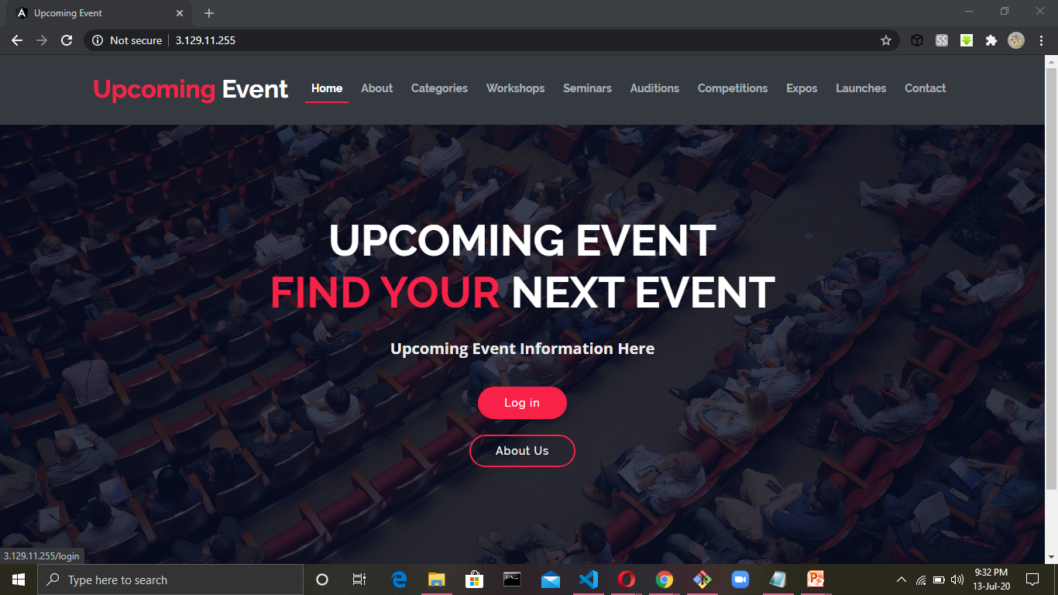
Home Page

Slide 7
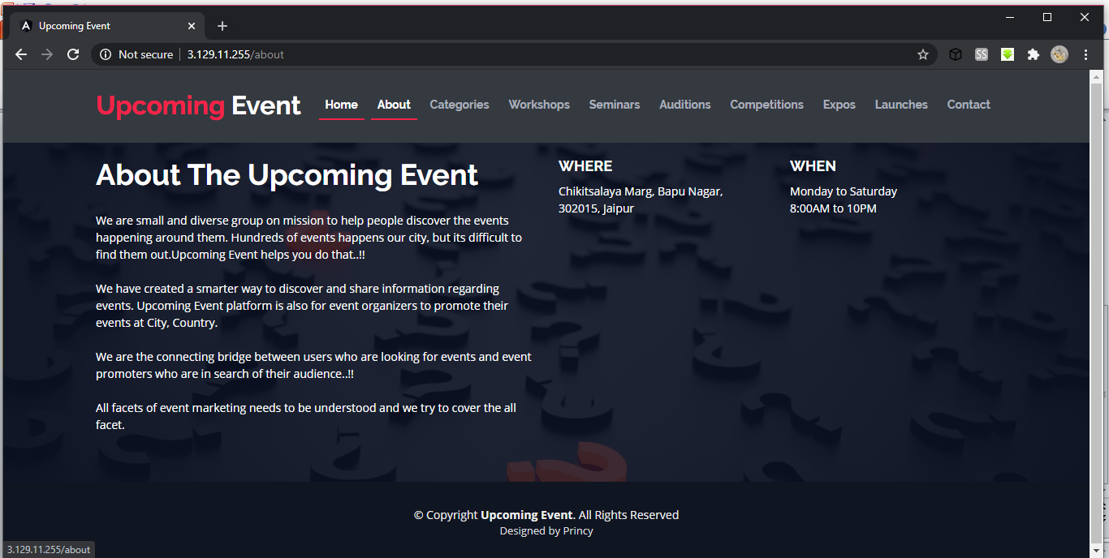
About Us

Slide 8
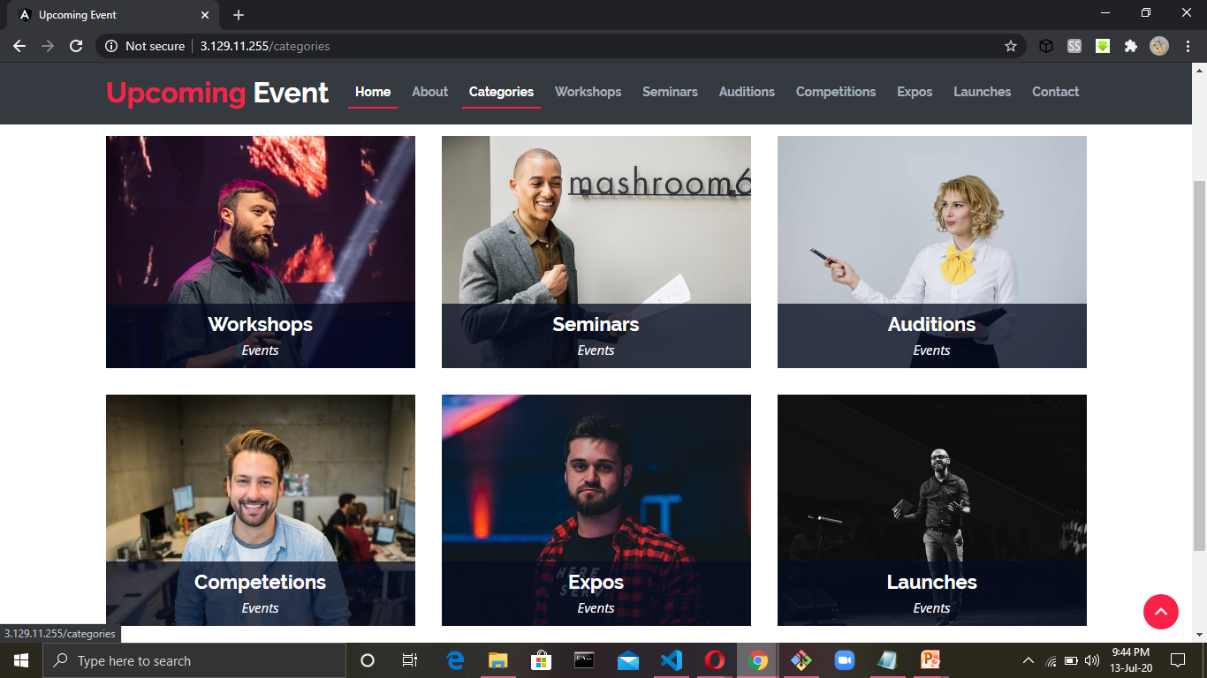
User Specification

Slide 9
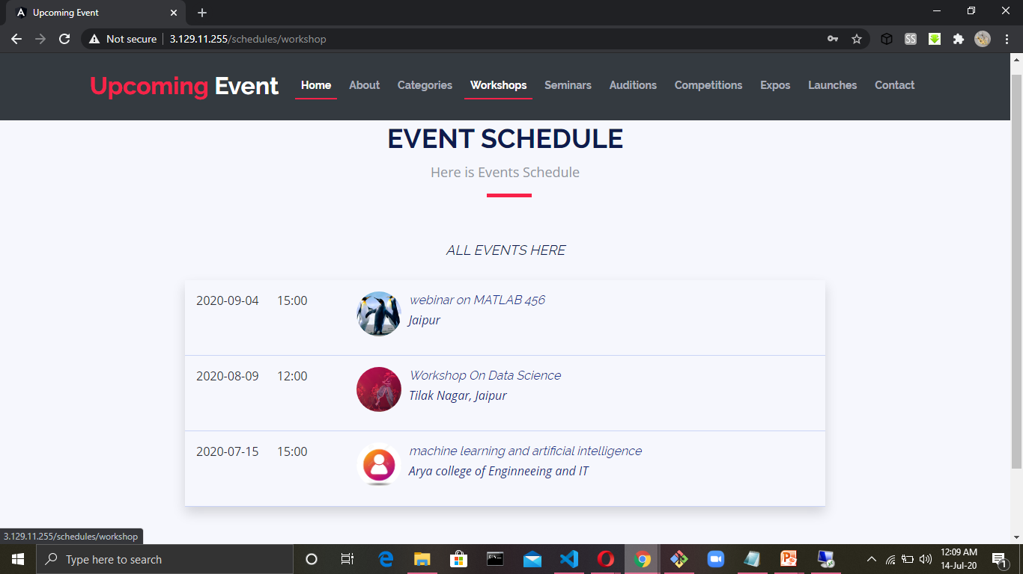
Workshops

Slide 10
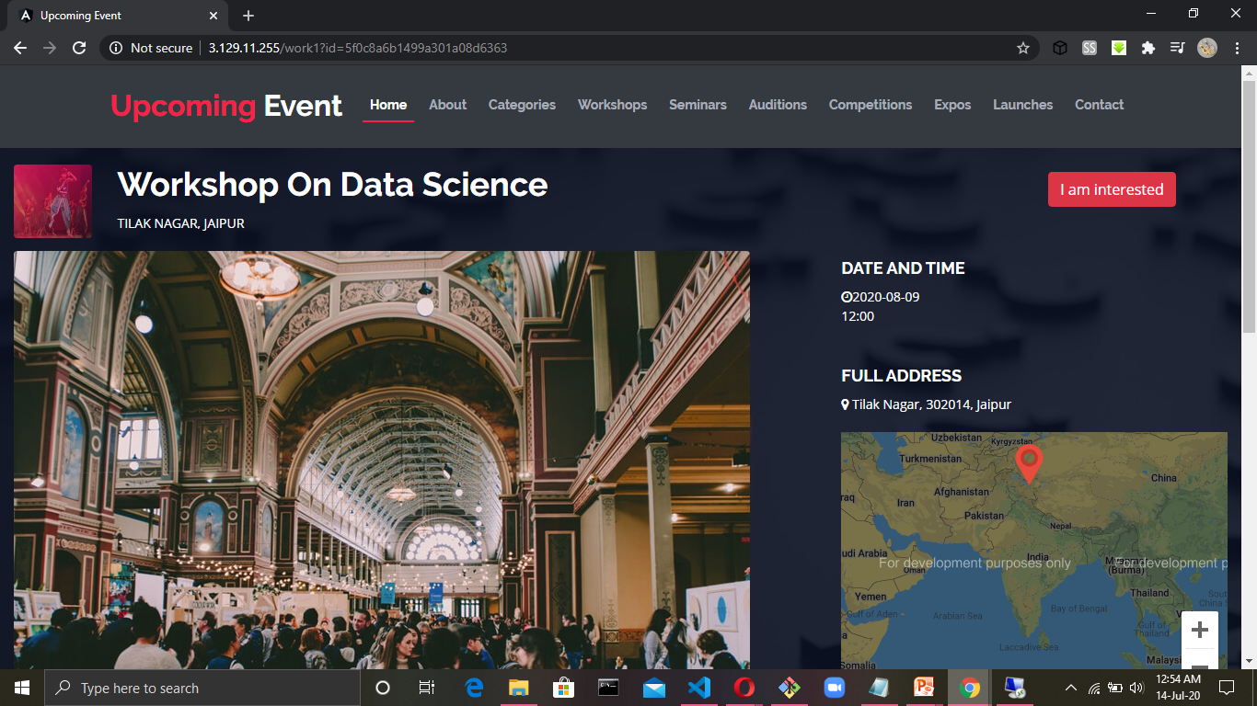
Detailed Schedule of the Event
Continue…

Slide 11
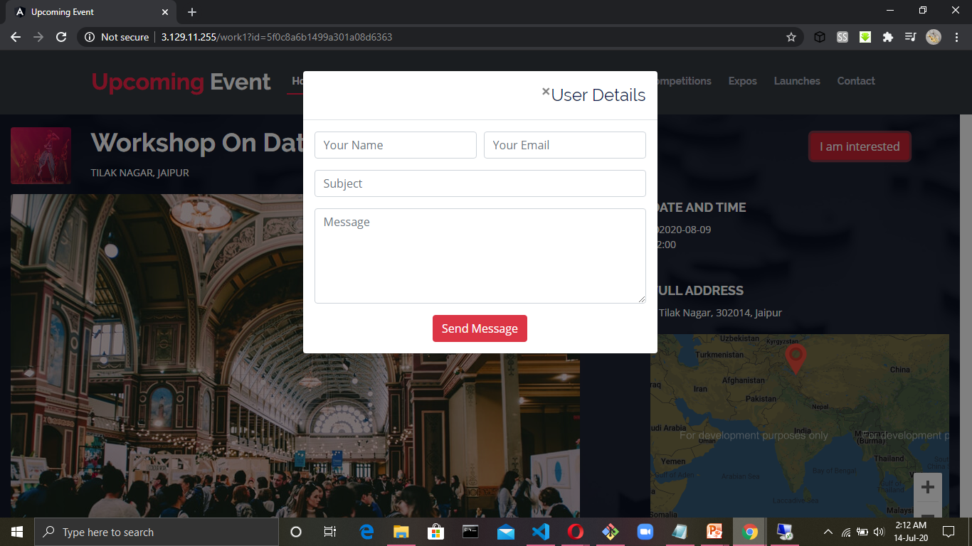
Interested Users

Slide 12
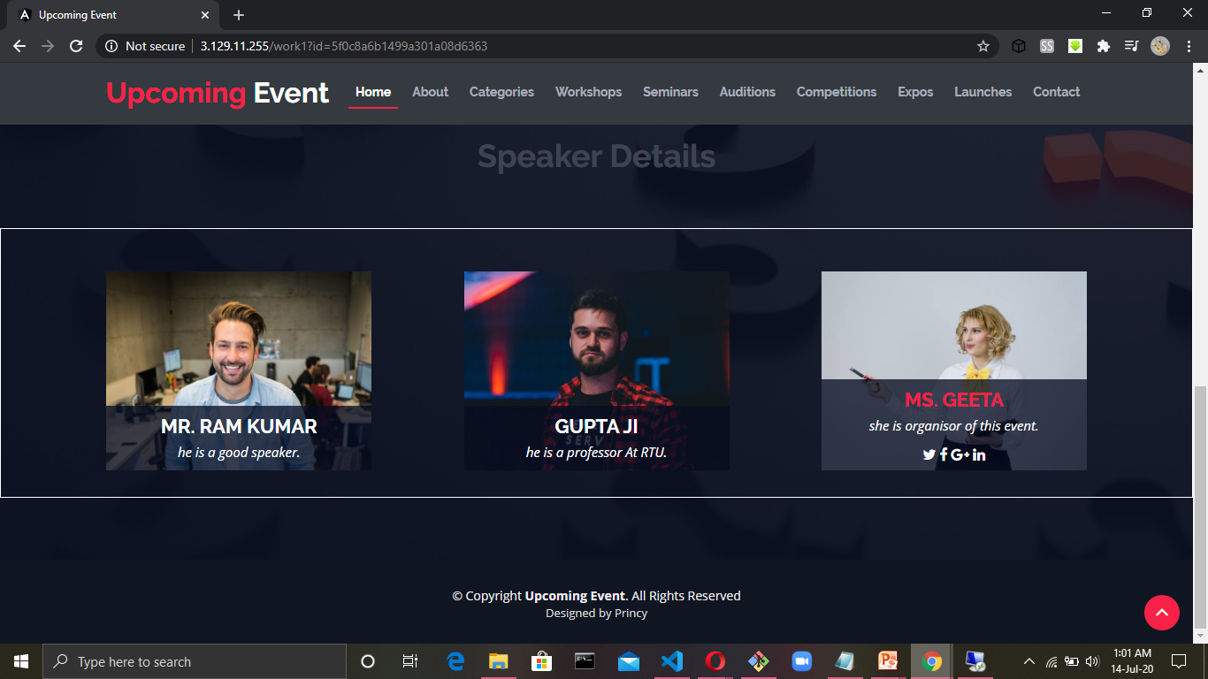
Speaker details of the Event

Slide 13
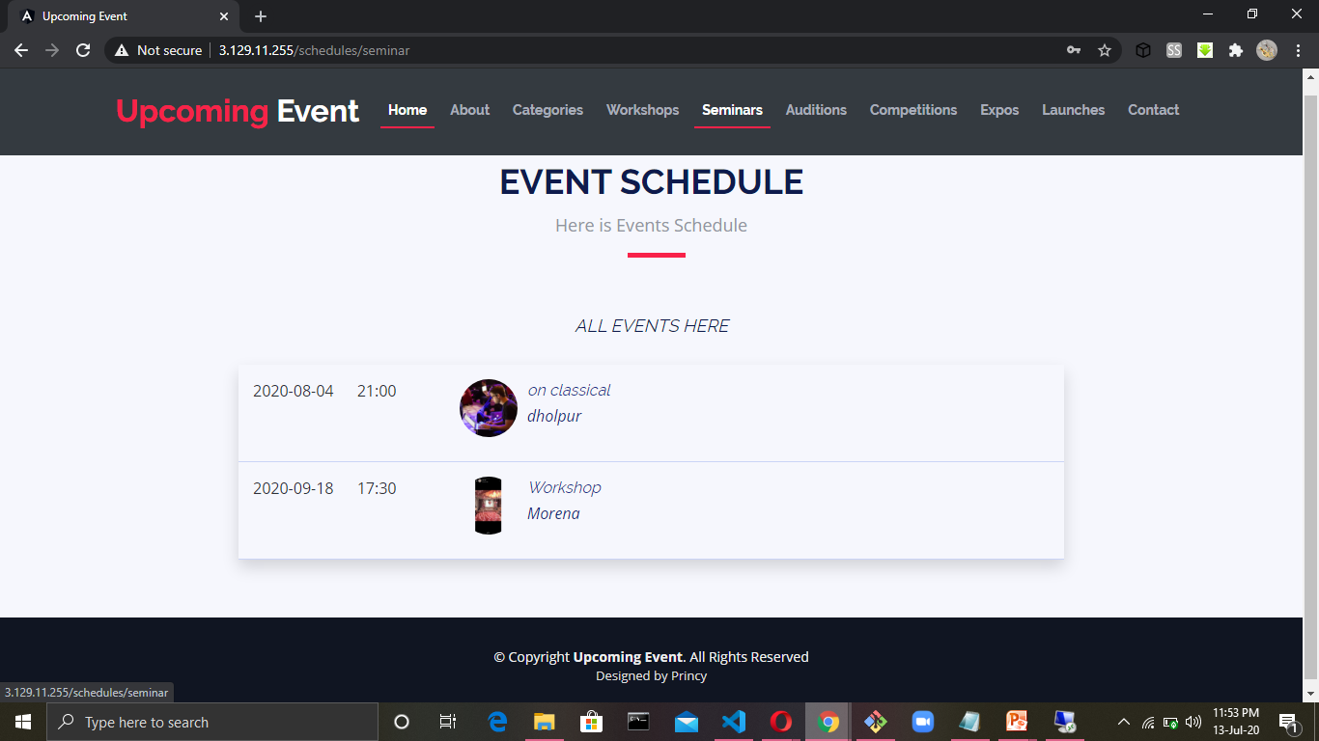
Seminars

Slide 14
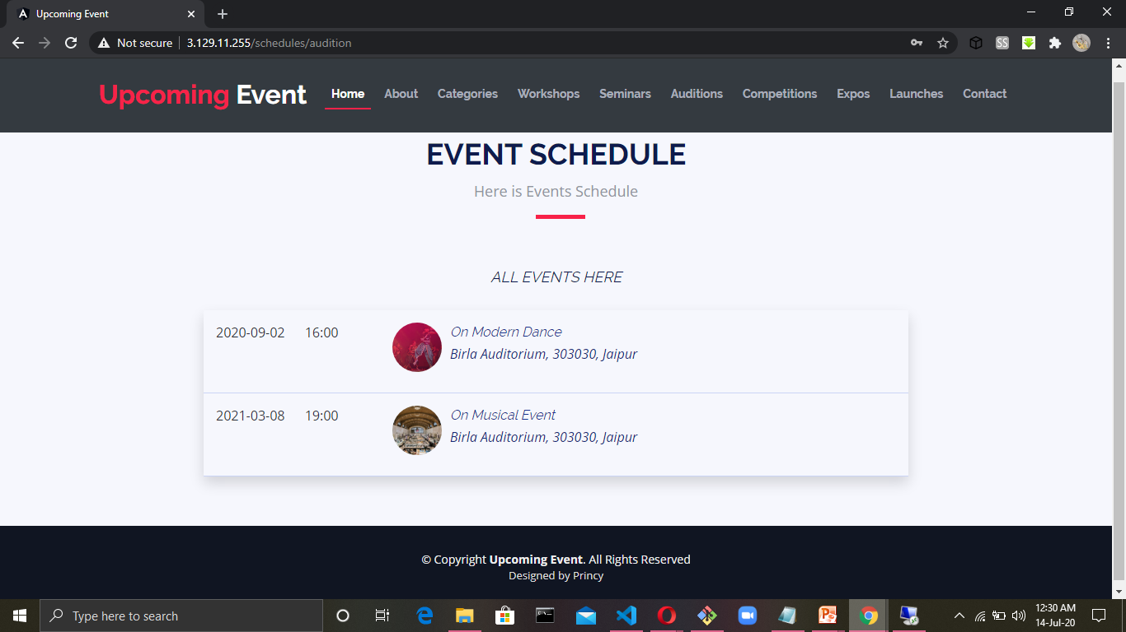
Auditions

Slide 15
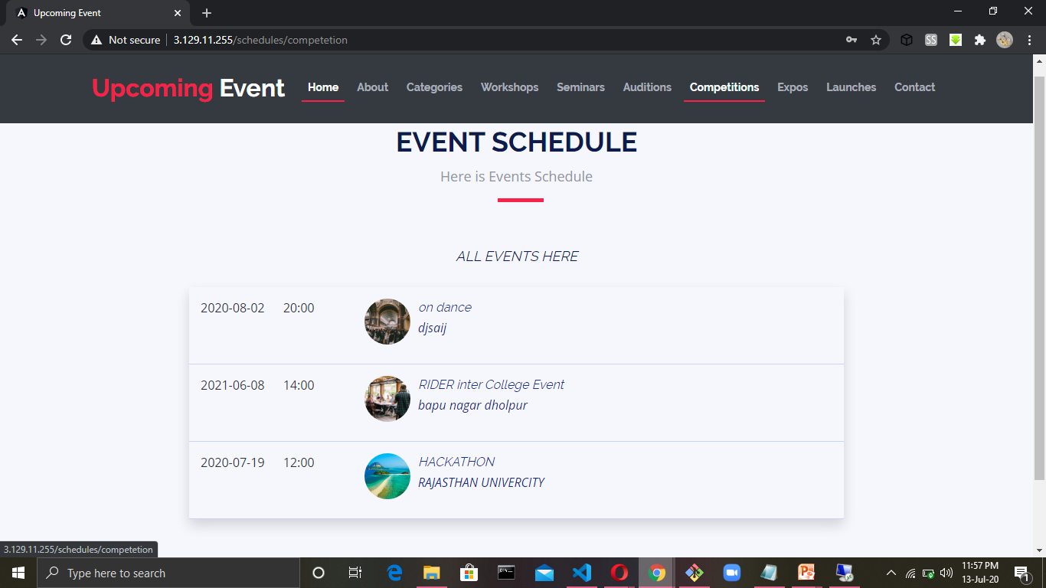
Competitions

Slide 16
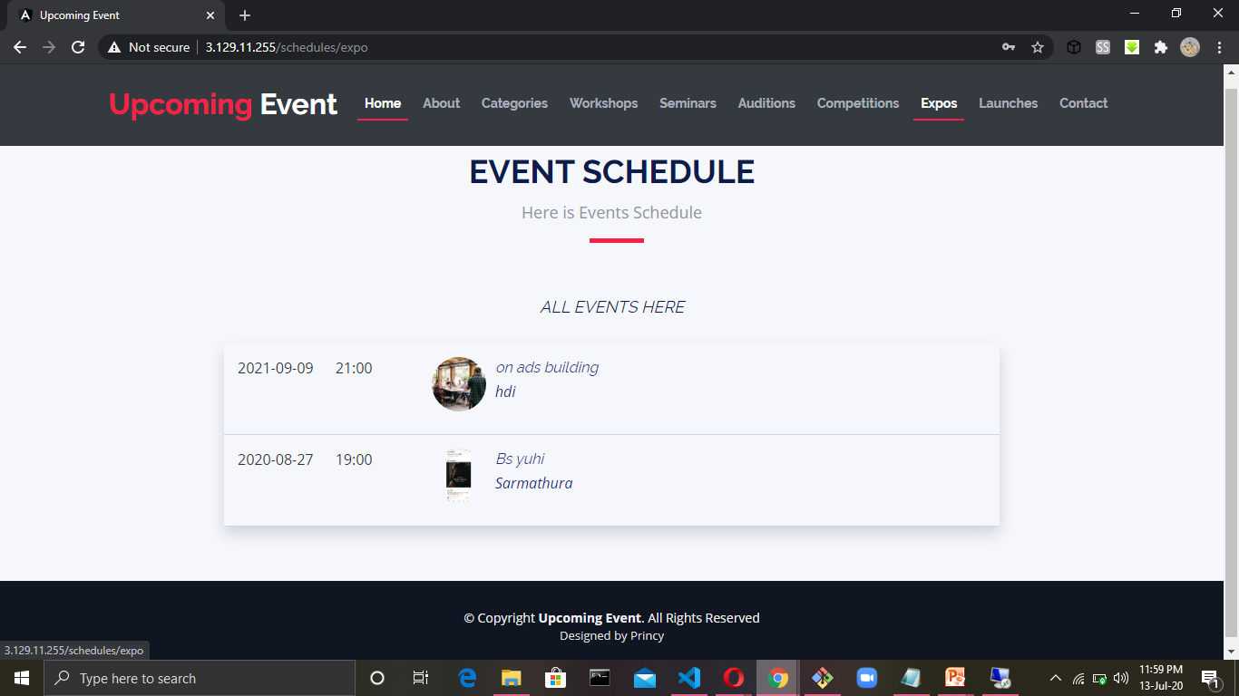
Expos

Slide 17
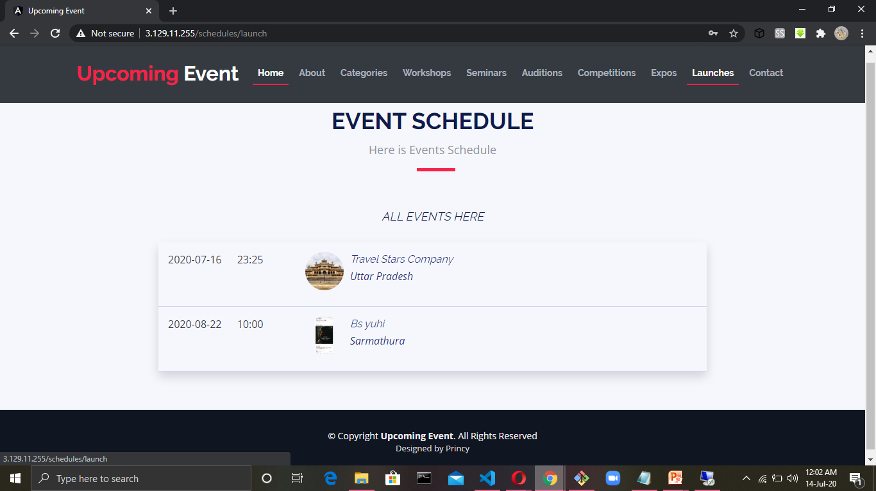
Launches

Slide 18
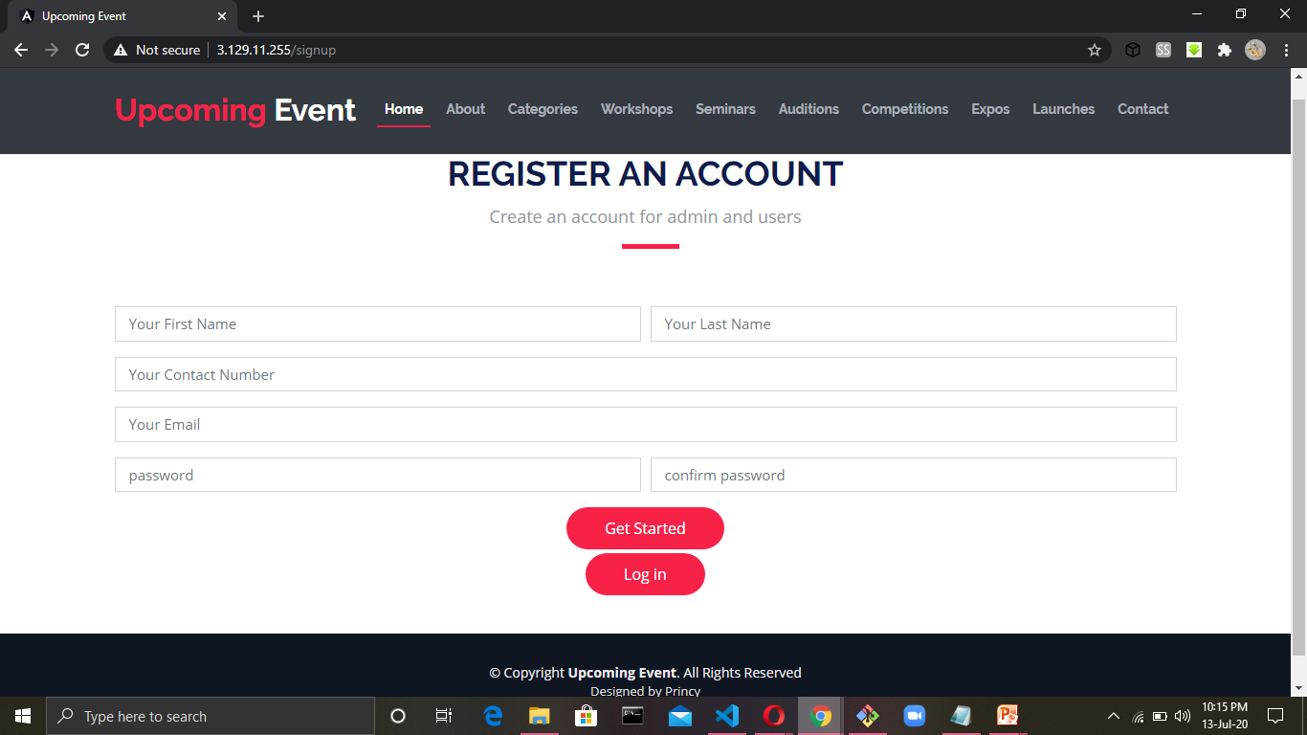
Register an Account

Slide 19
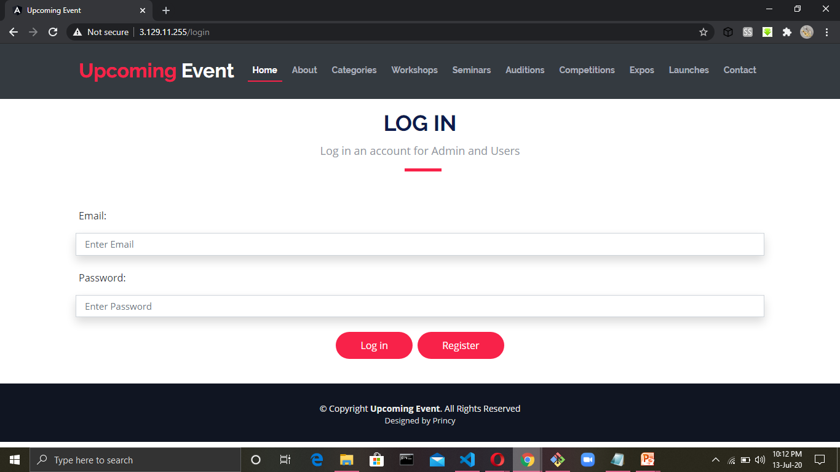
Login Page

Slide 20
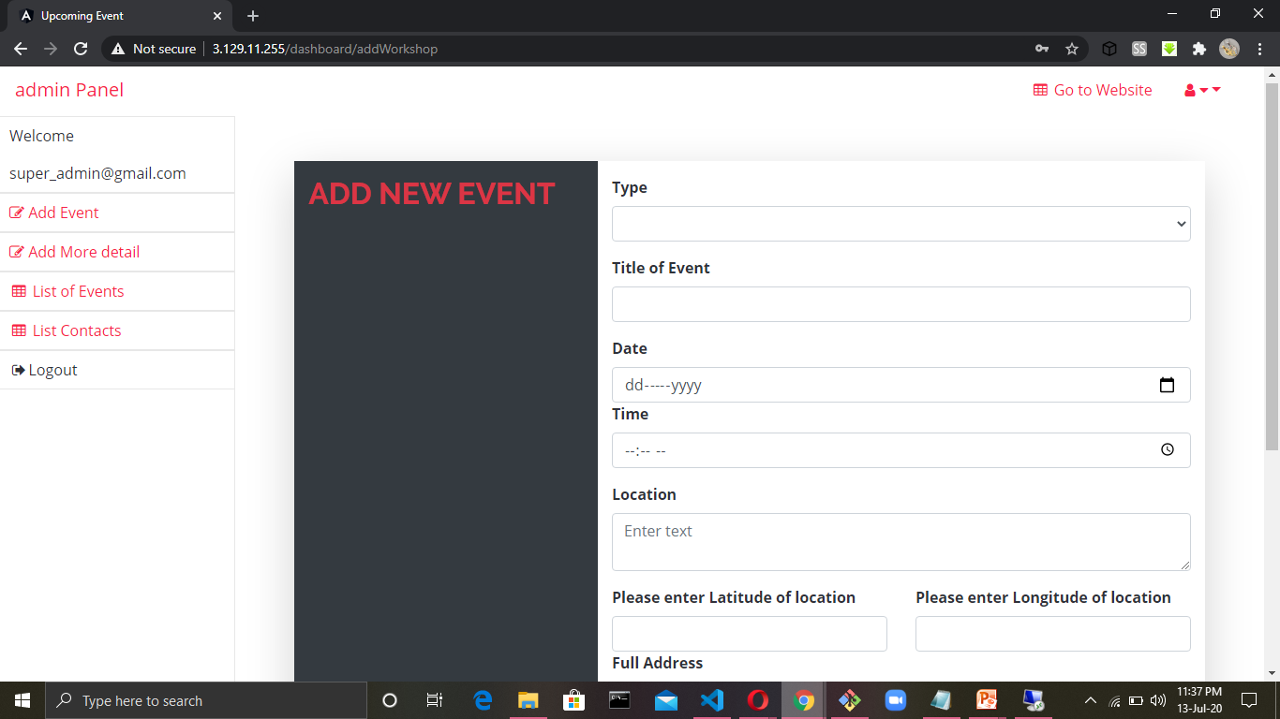
Admin Panel

Slide 21
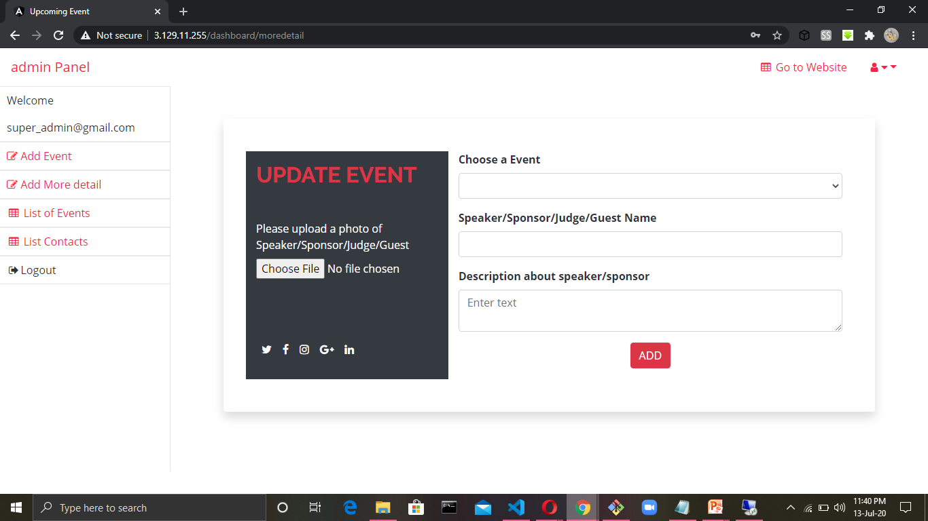
Add More details of Events

Slide 22
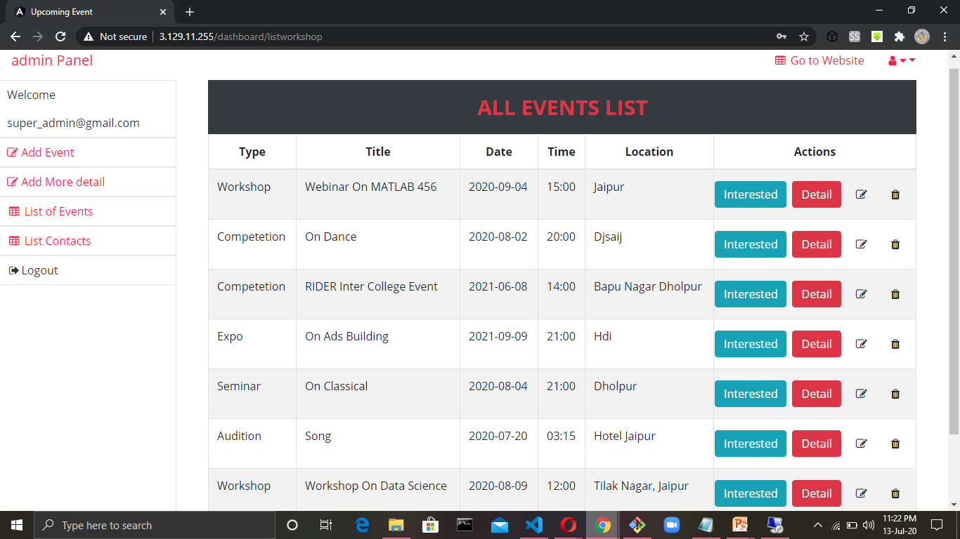
List of All Events

Slide 23
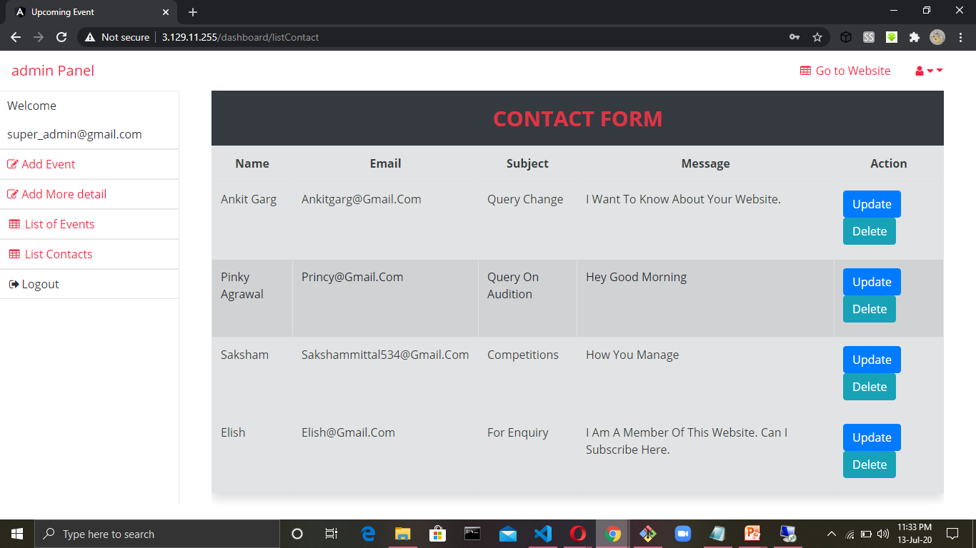
List of Contacts

Slide 24
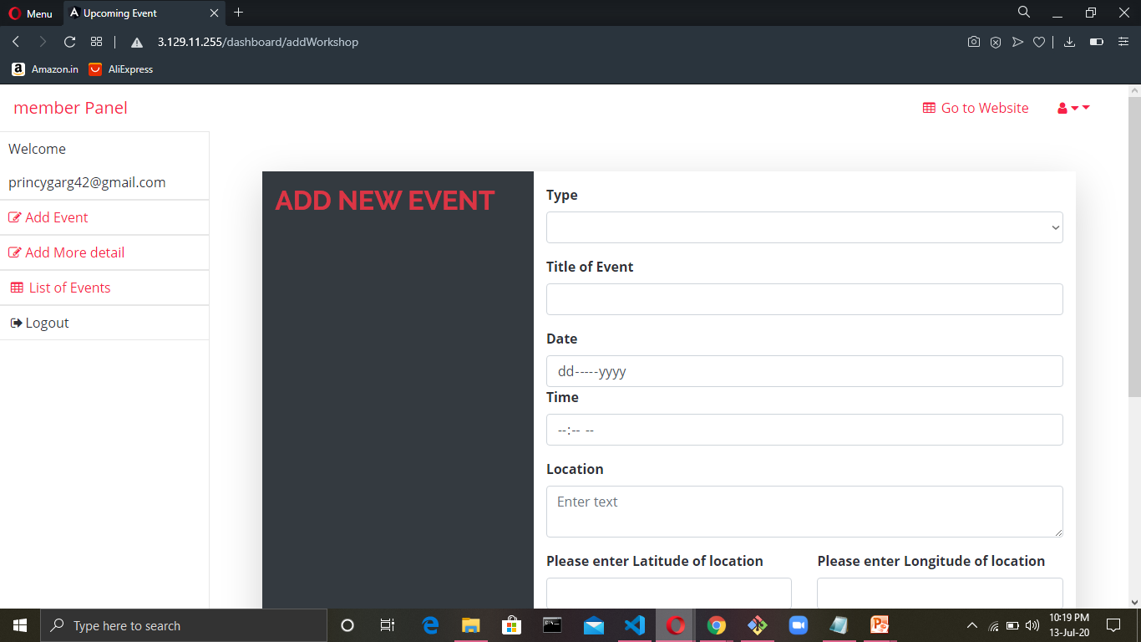
Member Panel

Slide 25
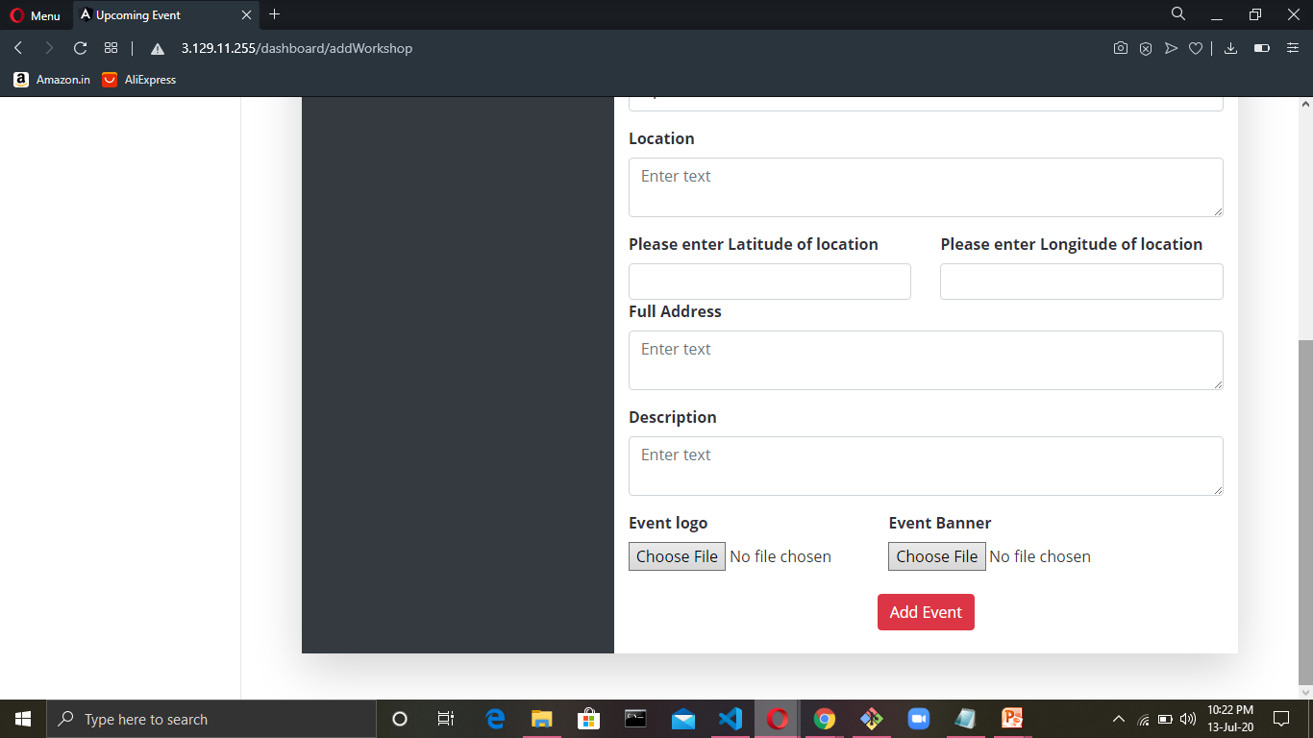
Continue..

Slide 26
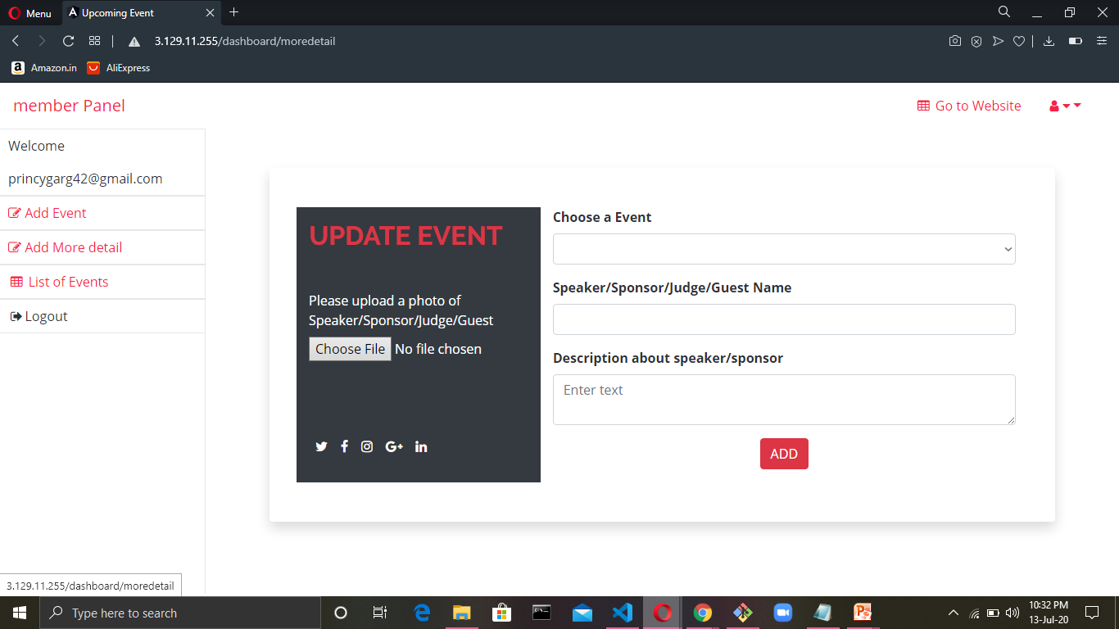
Add More details of Member’s Events

Slide 27
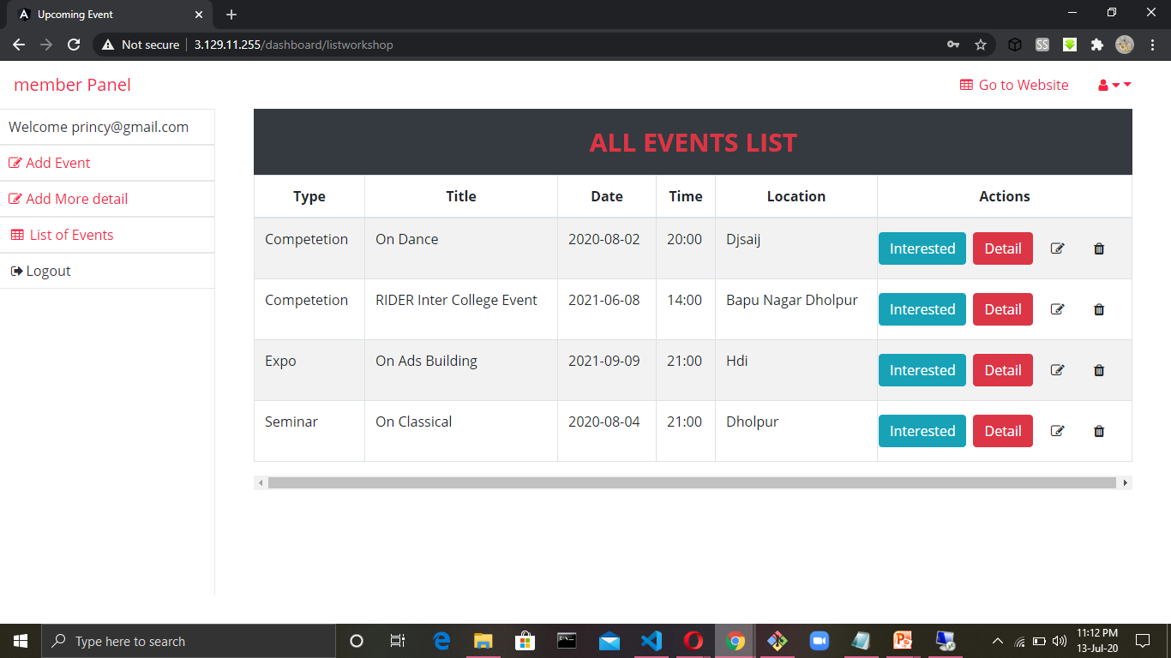
List of the Member’s Events

Slide 28
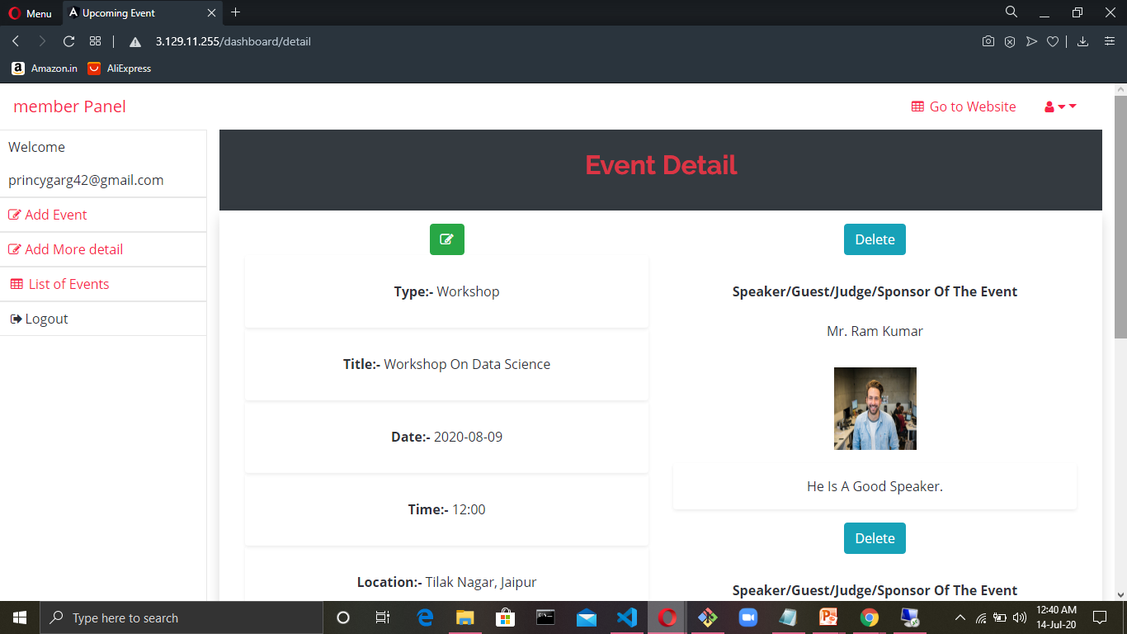
Complete detail of the Event

Slide 29
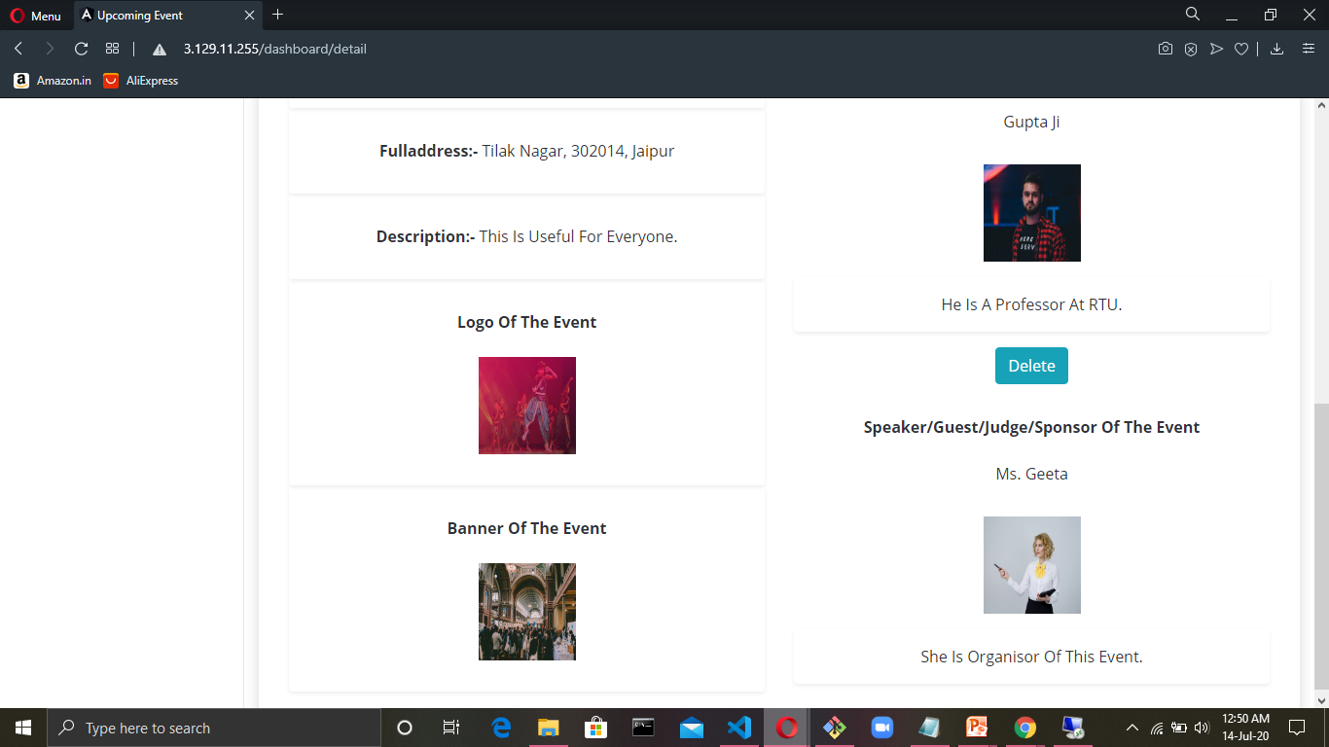
Continue…

Slide 30
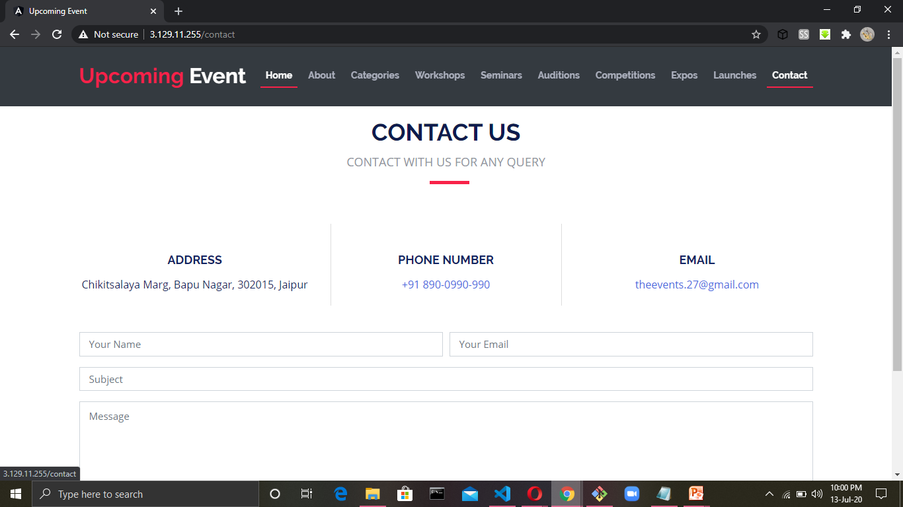
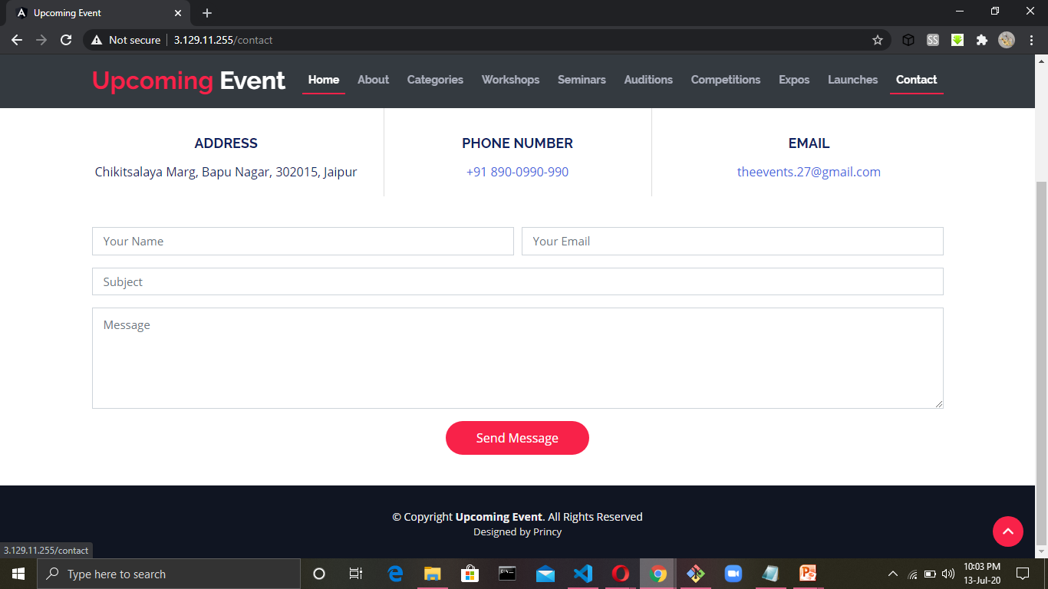
Contact Us

Slide 31
Thank You !!

